Slide 1
The Vector Projector Revisited
Gina Schmalzle
With Special thanks to Stuart Sandine, Andrea Fey and Thomas Ballinger

Slide 2
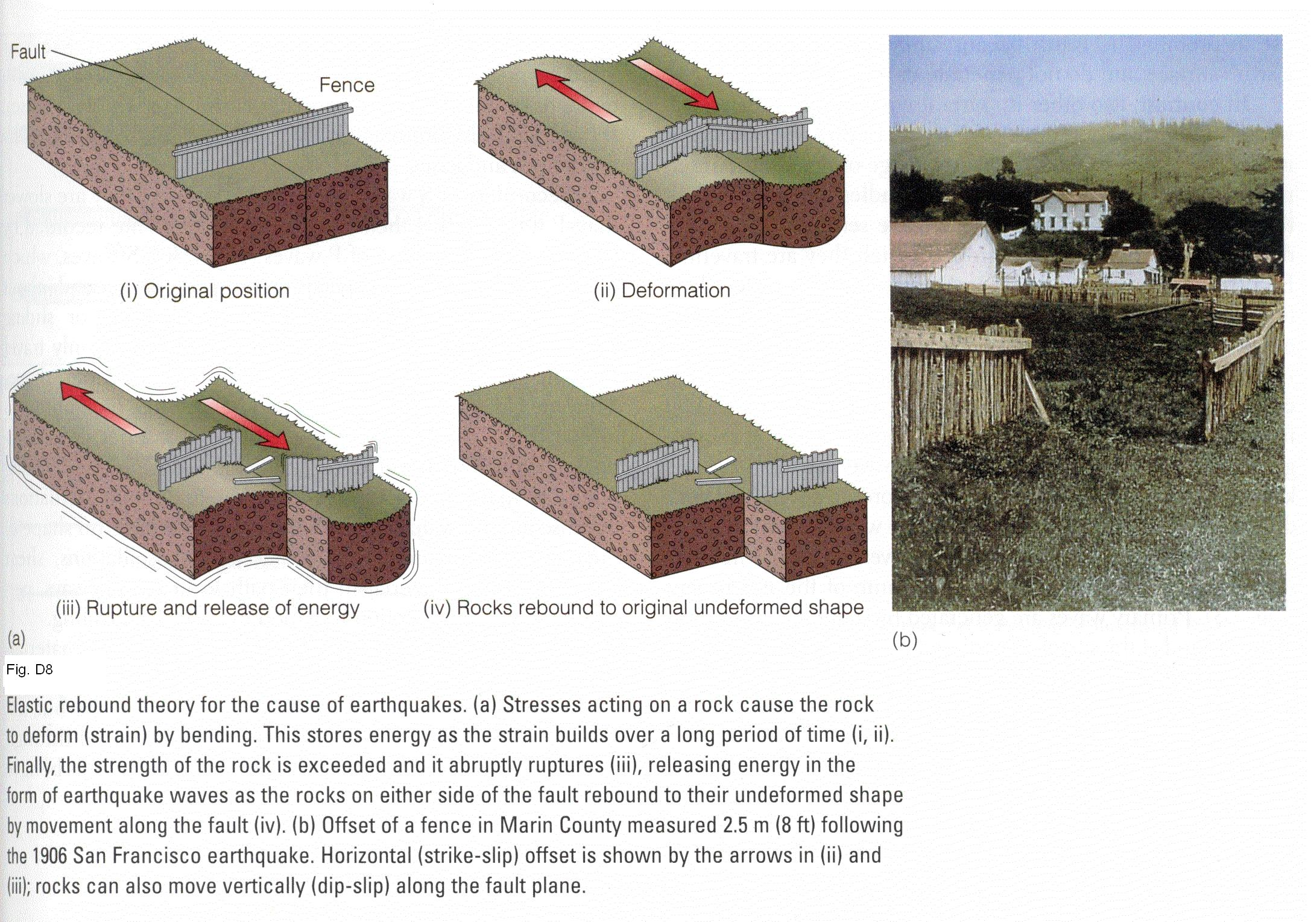
Last time we talked about Srike Slip Faults – ie., SAF
http://instruct.uwo.ca/earth-sci/240a/E9.JPG

Slide 3
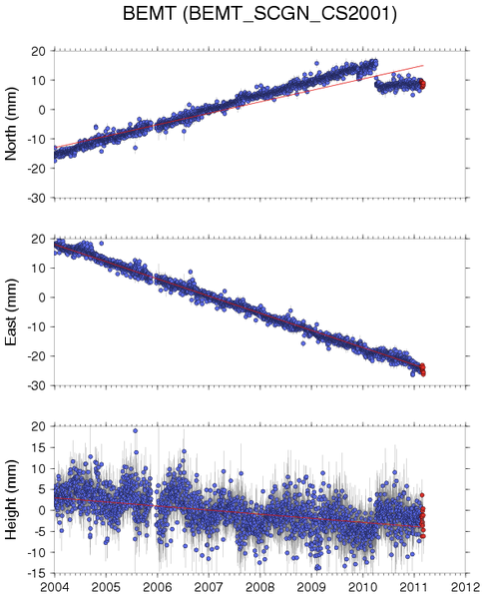
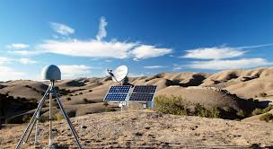
…And we talked about High Precision GPS
Blue dots – daily position estimates in North, East and Vertical directions for one site
Velocity is the slope.
Each site produces a velocity vector

Slide 4
…Now let’s talk about GPS vectors…
GPS Monument

Slide 5
…Now let’s talk about GPS vectors…
5 mm/yr
The GPS monument moved ~30 mm
Over ~6 years = 5 mm/yr

Slide 6
…Now let’s talk about GPS vectors…
8.3 mm/yr
The GPS monument moved ~50 mm
Over ~6 years = 8.3 mm/yr

Slide 7
…Now let’s talk about GPS vectors…
θ
5 mm/yr
8.3 mm/yr
GPS Rate = sqrt(5^2+8.3^2) =
9.69 mm/yr
θ = atan (8.3/5) = 59 degrees

Slide 8
Now let talk vector projections…
R perp
R
Transect Line
(Could represent
fault trace)
θ
τ
R par
R perp= R*sin(τ)
R perp= R*cos(τ)
Who Cares?
If transect line follows a fault then Rperp tells you if the sides of the fault are moving together or apart and Rpar tells you how much they are moving past each other.

Slide 9
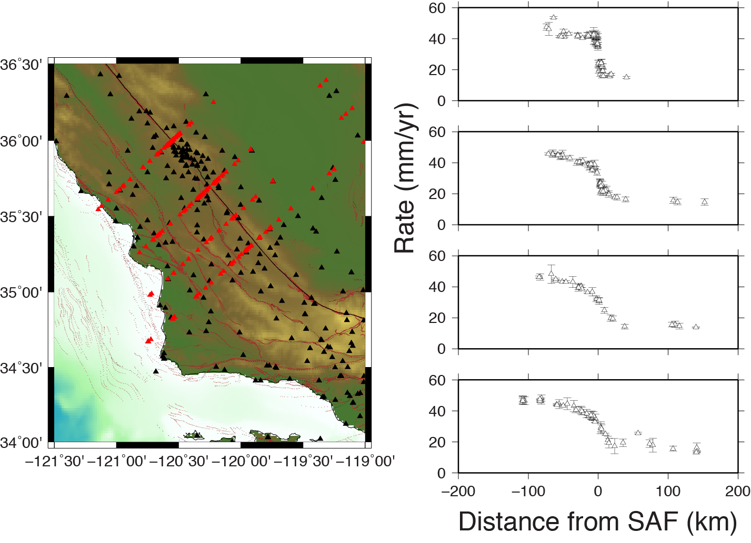
Example of vector projections onto profiles

Slide 10
Now, Let’s take a look at the new and improved Vector projector…

